Slide 1


Project developed during AI Internship
at IBM using Auto AI on IBM Cloud
Auto AI Model Building
with IBM Watson Studio
Presented By: Vaishnavi Kesarwani
Mentor: Mr. Samarth Amrute
Project: House Price Prediction using IBM Watson Studio( Auto AI)

Slide 2
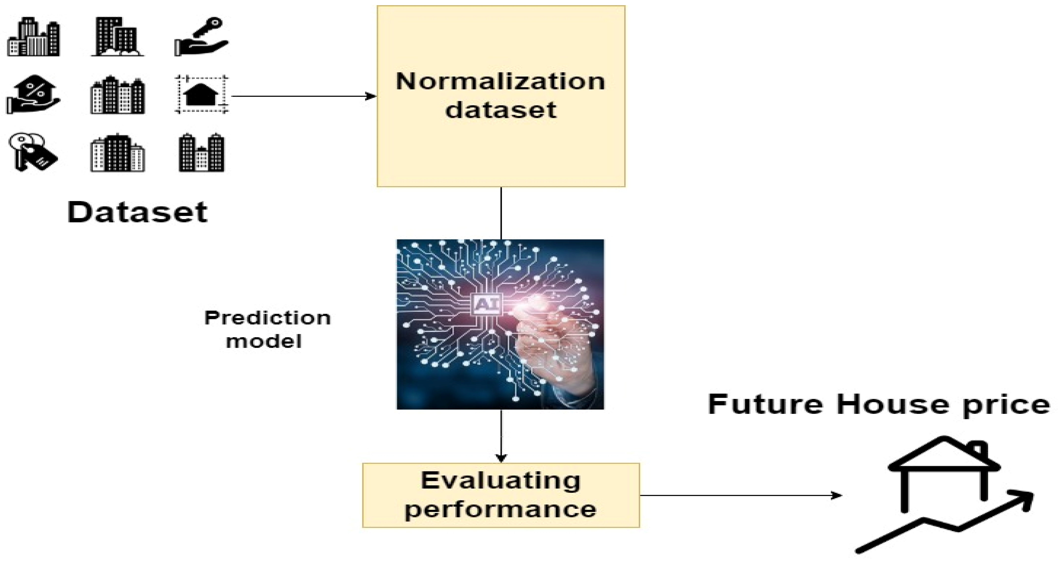
Agenda
1.Introduction
2.Dataset Overview
3.Tools & Services Used
3.IBM Watson Studio Setup
4.AutoAI Overview
5.Model Configuration
6.Deployment
7.Output
8.Conclusion

Slide 3

Introduction
Accurate house price prediction is essential in the real estate industry, helping buyers, sellers, and investors make informed decisions. This project aims to develop a machine learning model using IBM Watson Studio’s Auto AI, which automates the end-to-end AI lifecycle including model selection, data preprocessing, feature engineering, and evaluation. By utilizing various housing features such as number of bedrooms, bathrooms, area, location, and more, the model provides reliable price predictions. This approach not only saves time but also ensures high accuracy and scalability, making it practical for real-world deployment.

Slide 4
Dataset Overview
The dataset includes housing-related features that impact property prices :
🛏️Bedrooms
🛁Bathrooms
📐Square Footage
🧱 Floors, Basement, Rennovations
🌊Waterfront view
🏡Property Condition
📆Year Built
📍Location
📂 Source: Kaggle Housing Dataset
☁️Storage and Access: Uploaded to IBM Cloud , used in Watson Studio(Auto AI)

Slide 5

Tools & Services Used
IBM Watson Studio:
For building, training, and evaluating machine learning models.
AutoAI (IBM):
Automated ML tool for pipeline creation, model selection, and tuning.
IBM Cloud Object Storage:
To store and connect the dataset for training.
Watsonx.ai Runtime:
For model deployment and scalability.
Google Colab:
Used for testing and integrating the downloaded model.

Slide 6
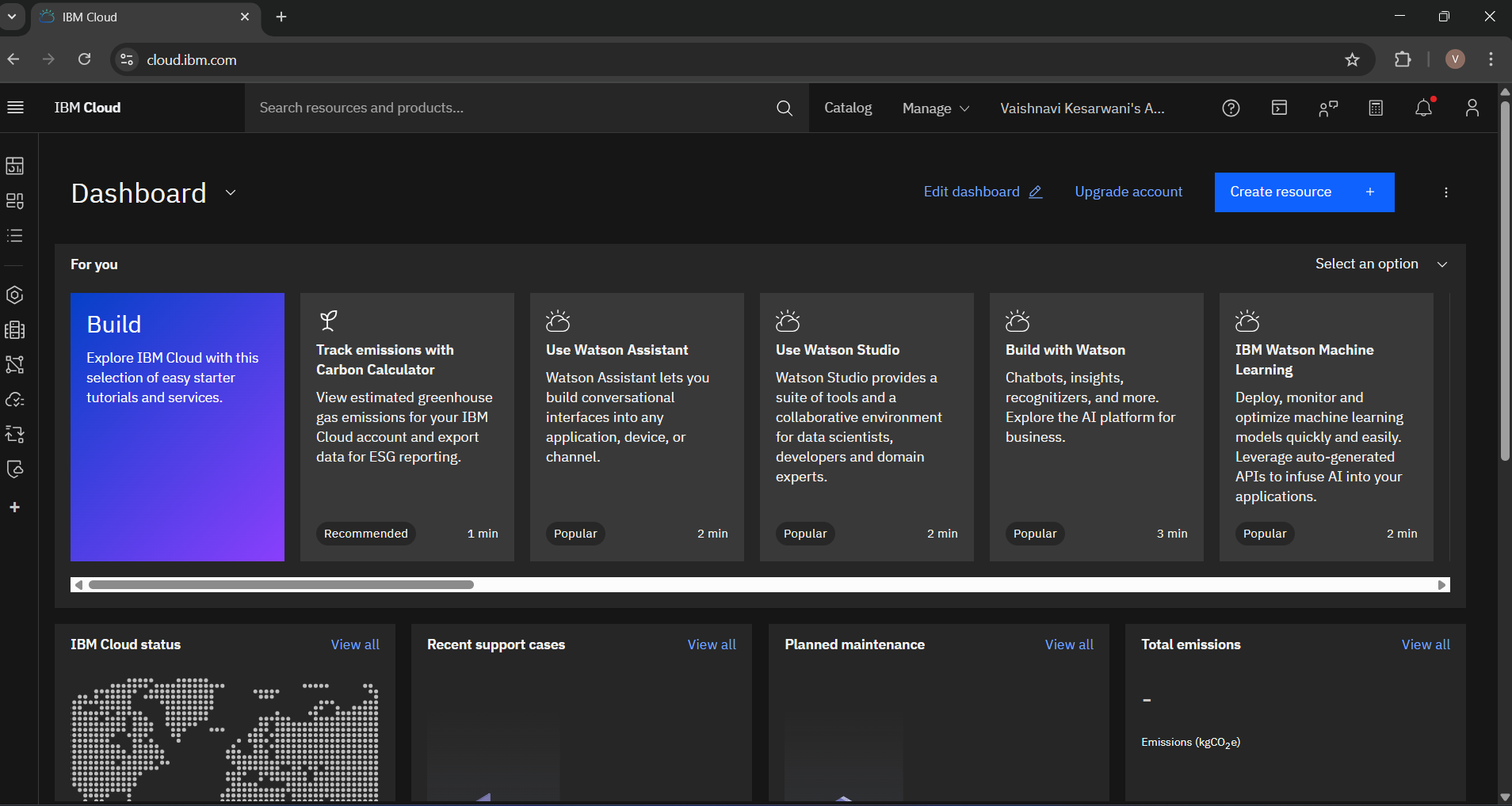
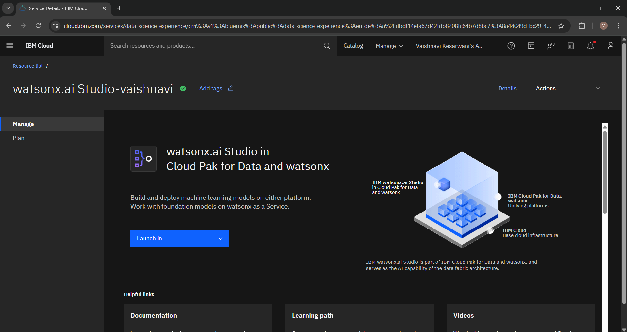
Watson Studio Setup
IBM Watson Studio is a cloud-based platform for building and training AI models. It simplifies data science workflows with AutoAI.
1. Login to IBM Cloud and then following dashboard will appear.
2. Create watsonx.ai Studio .

Slide 7
AutoAI Overview
AutoAI is a tool in IBM Watson Studio that helps build machine learning models automatically.
It cleans and prepares the data.
Tries different algorithms like XGBoost, Linear Regression, etc.
Tunes the models to get the best results.
Creates multiple model pipelines to choose the best one.
It makes the whole process faster and easier without much coding.

Slide 8
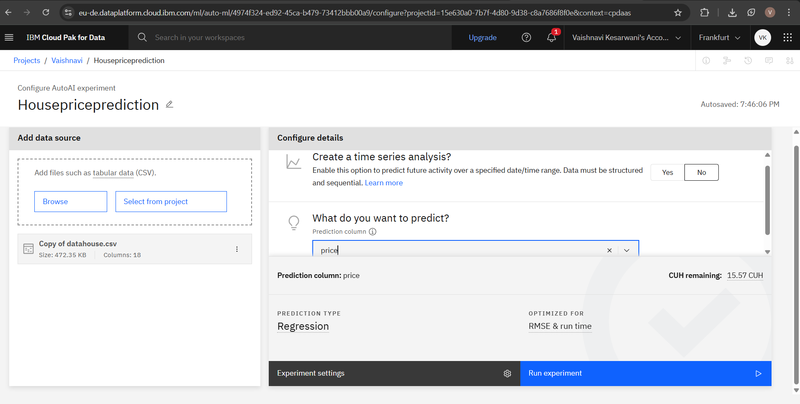
Model Configuration
In this project, the goal is to predict the house prices using a regression model.
Target variable: House Price Input features: Bedrooms, Bathrooms, Sqft Living, Location, etc. Task: Regression

Slide 9
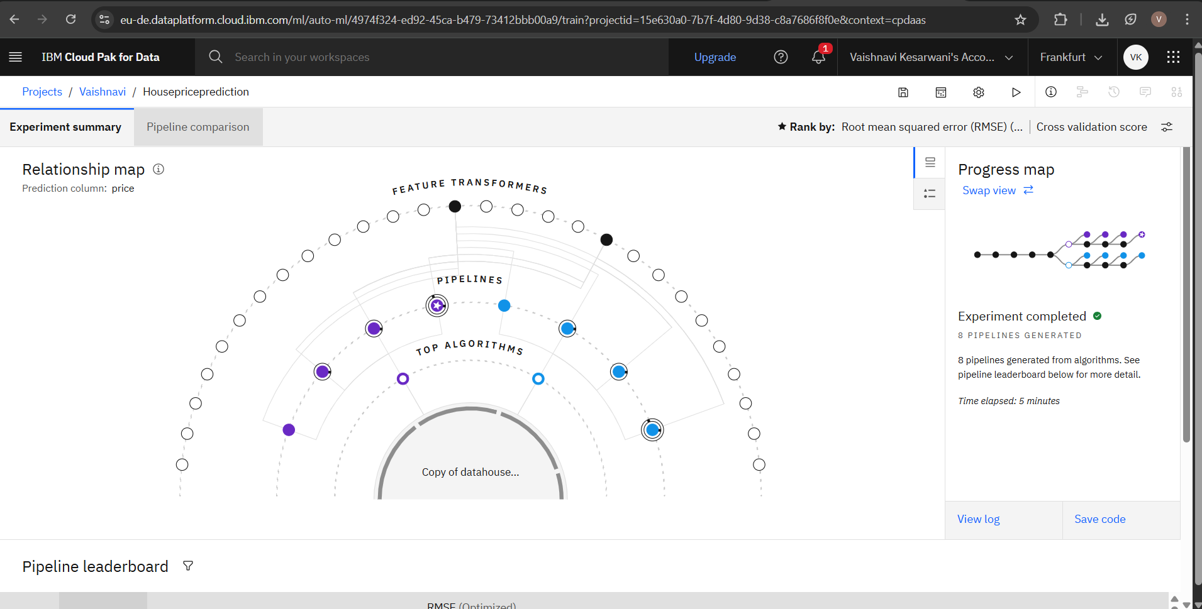
Data Preprocessing
AutoAI handles missing values, encodes categorical variables, and normalizes data automatically for optimal model performance.

Slide 10
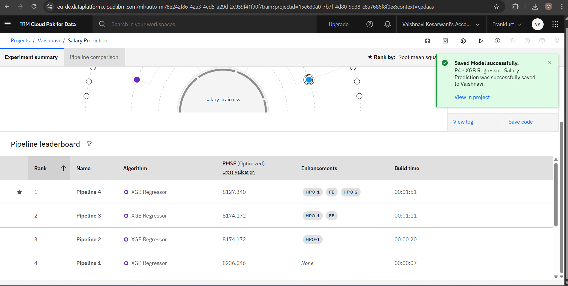
Model Building
AutoAI builds multiple pipelines using algorithms like Linear Regression, XGBoost, and Random Forest and ranks them by accuracy.

Slide 11
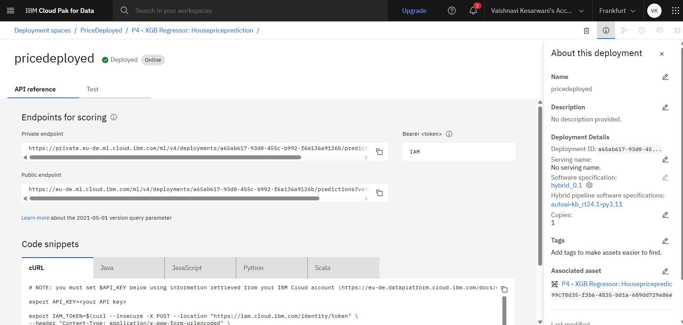
Deployment Overview
After selecting the best model (XGBoost Regressor), deployment was done using IBM Watson Studio.
The model was deployed in the Deployment Space.
IBM generated Public and Private Endpoints for prediction.
These endpoints allow the model to make real-time predictions.
The deployment ensures the model is easily accessible and reusable.

Slide 12
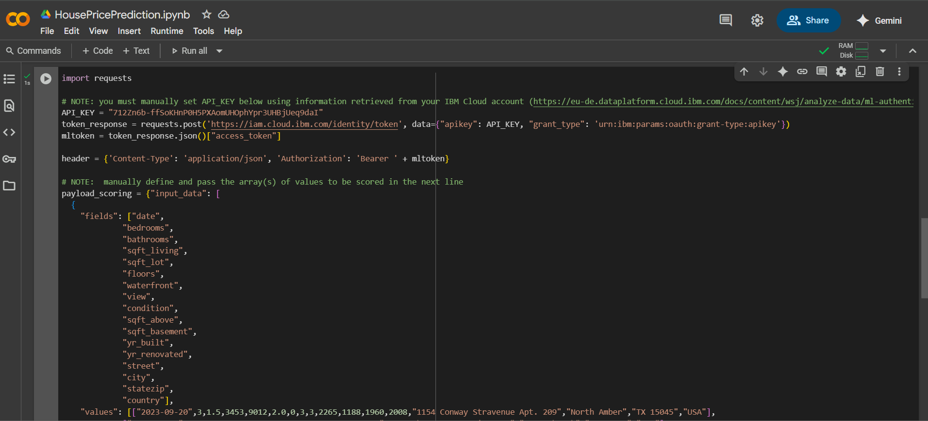
Google Colab Integration
After deployment, the model was tested and used in Google Colab to make predictions. This helps to verify that the model works well outside Watson Studio.

Slide 13
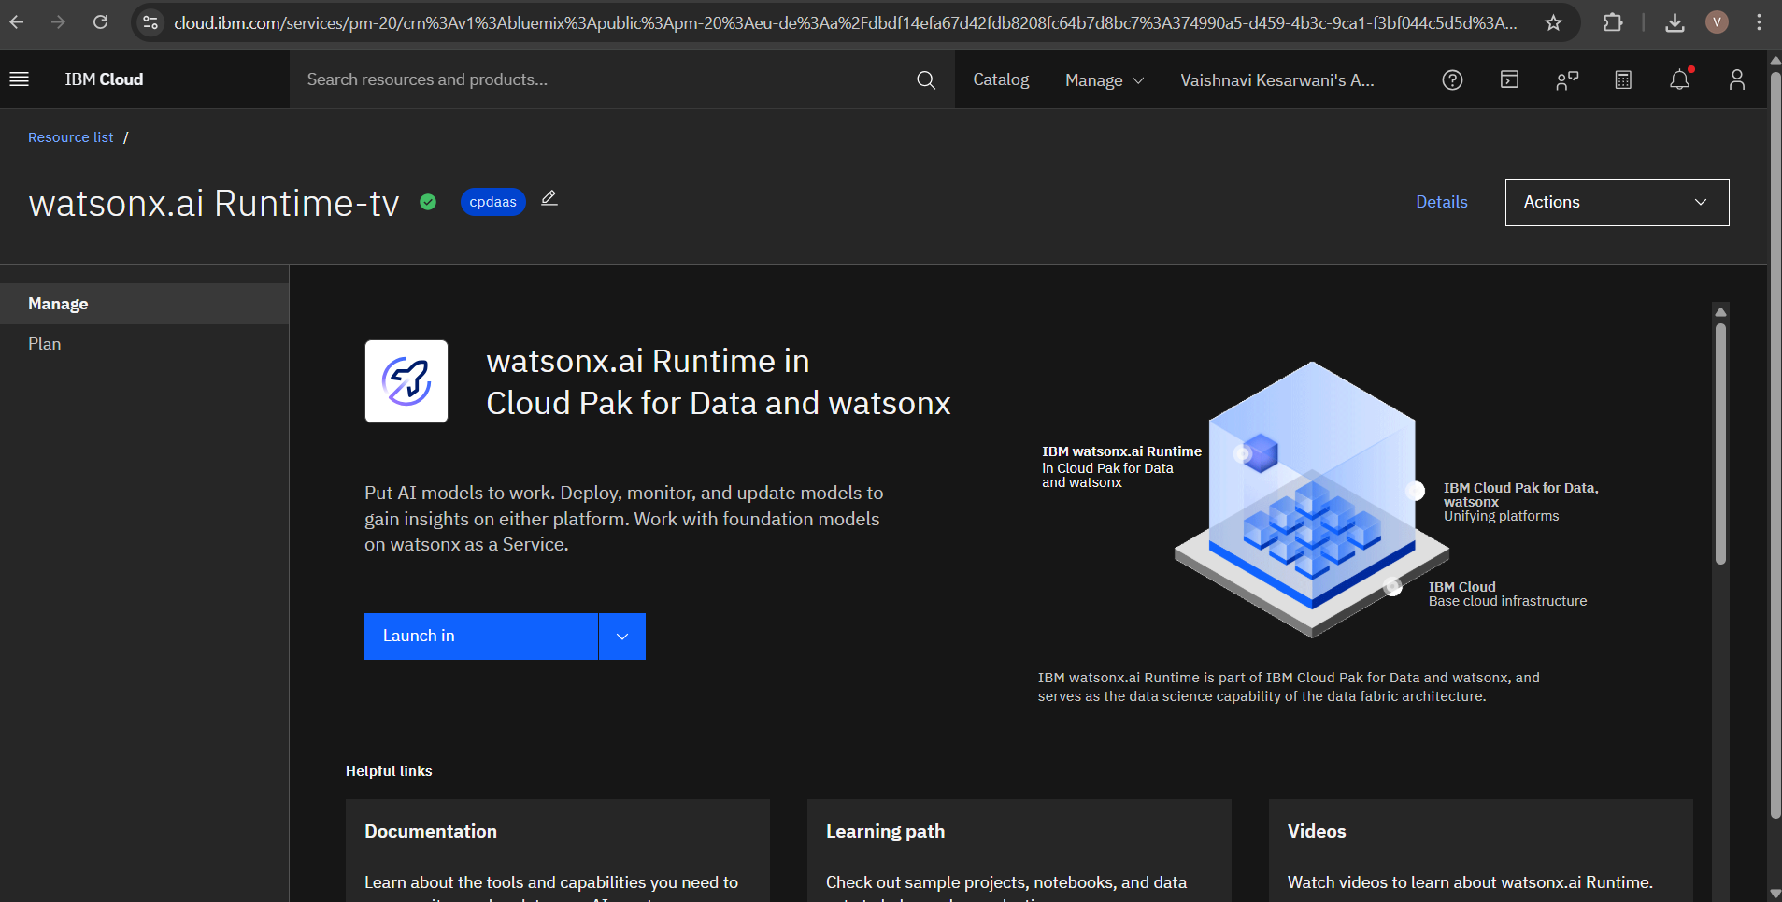
watsonx.ai Runtime
The model can be deployed via watsonx.ai Runtime for cloud-based API integration, monitoring, and scalability.

Slide 14
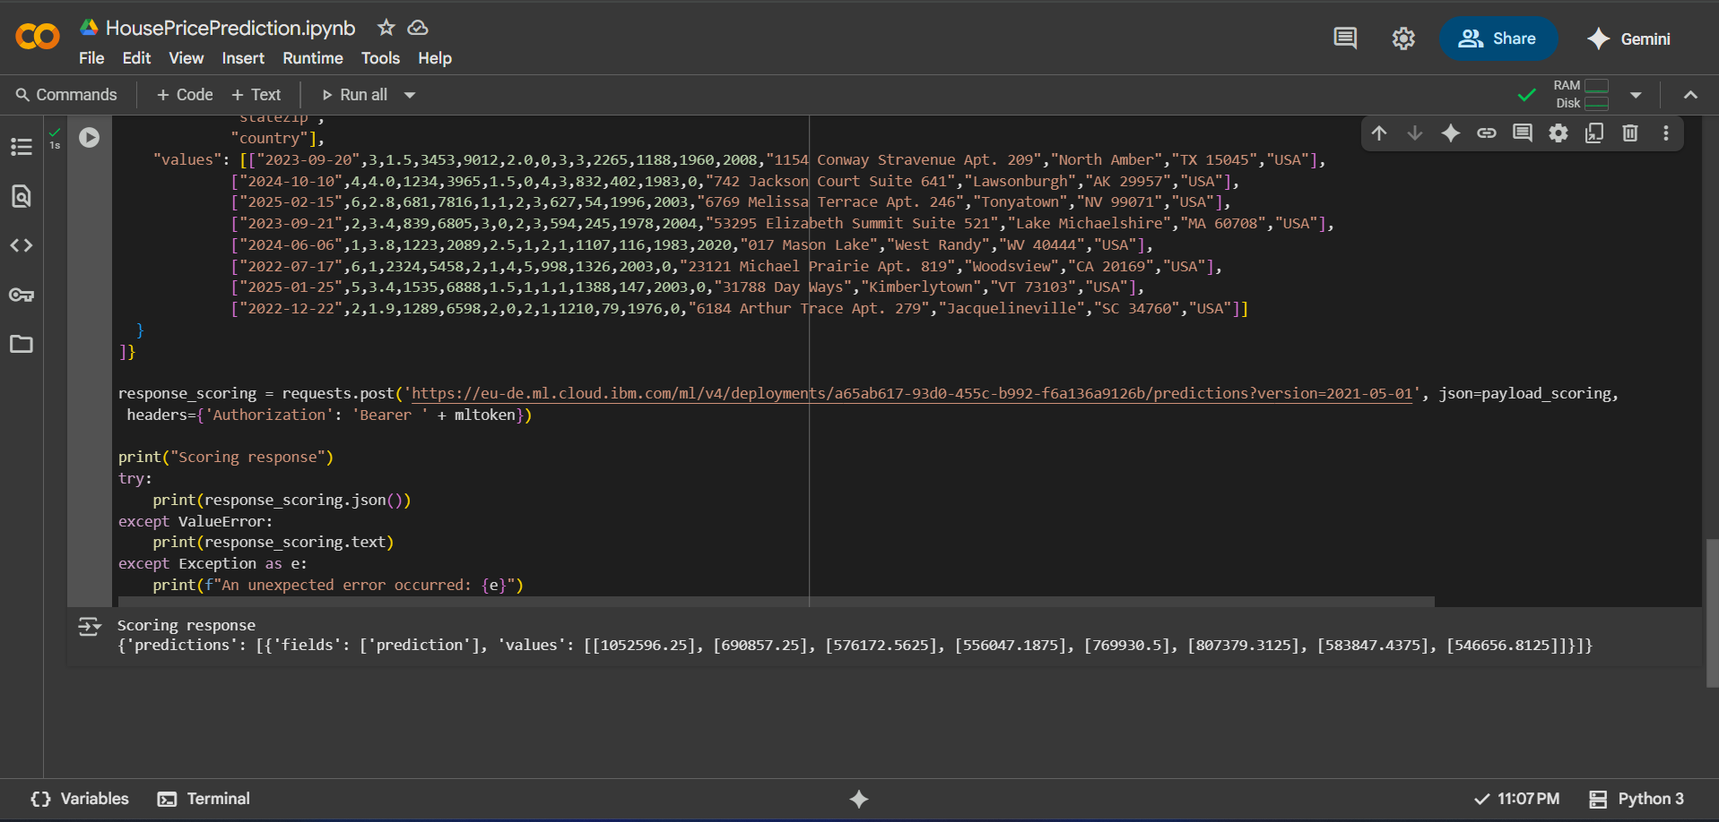
Output & Impact
The best-performing model, XGBoost Regressor, achieved an R² score of 0.89, indicating strong prediction accuracy.
It was able to predict house prices based on features like location, area, rooms, etc.
Predictions tested in Google Colab confirmed reliable performance.
The project shows how AutoAI accelerates ML development with minimal coding.
This solution can support real estate companies and buyers in data-driven decision making.

Slide 15
Conclusion
AutoAI simplifies machine learning development. This project demonstrates end-to-end ML workflow from data to deployment using IBM Watson.
Working on this project provided valuable hands-on experience in using AI tools for solving real-world problems.
Using IBM Watson Studio's AutoAI, I was able to explore the complete machine learning workflow from uploading a dataset to building, evaluating, and deploying a predictive model.
The project helped me understand:
The importance of clean and structured data.
How automated ML tools like AutoAI simplify complex processes
The practical use of cloud platforms for deploying AI models.

Slide 16
THANK YOU

